Slide 1
- Johns Hopkins University School of Medicine - Oncology Tissue & Imaging Services (OTIS) Core Lab Pathology Department Onboarding Presentation for New Core Users
Director: Alan Meeker, PH.D.
Laboratory Manager: Miklhail James, M.P.H.
411 N. Caroline St., Basement, B310 | Bond St., Annex Building
Baltimore, MD. 21231

Slide 2
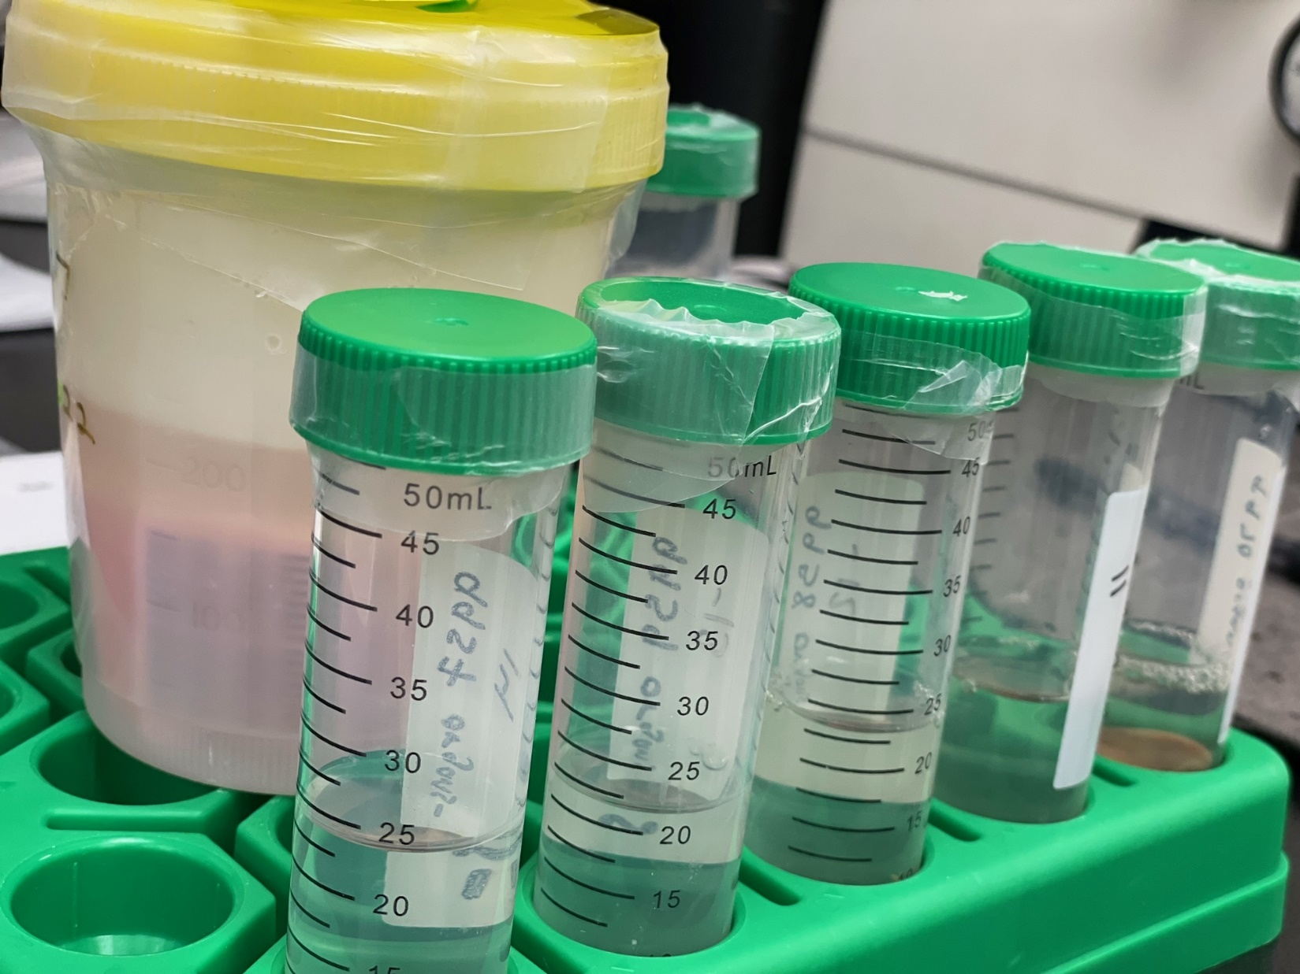
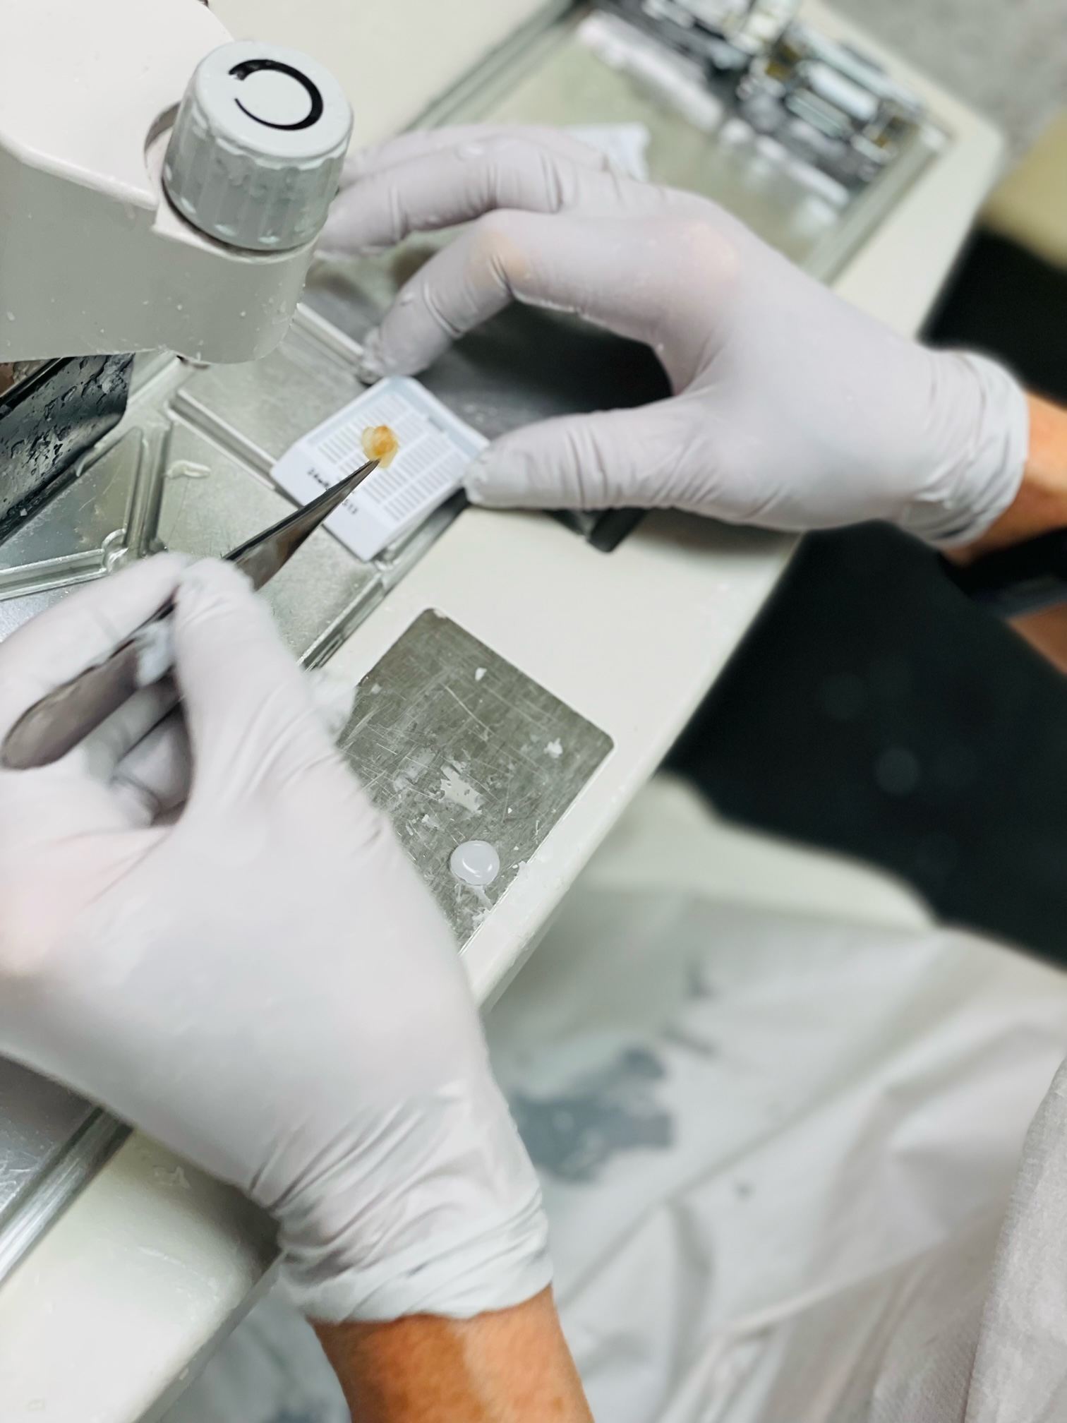
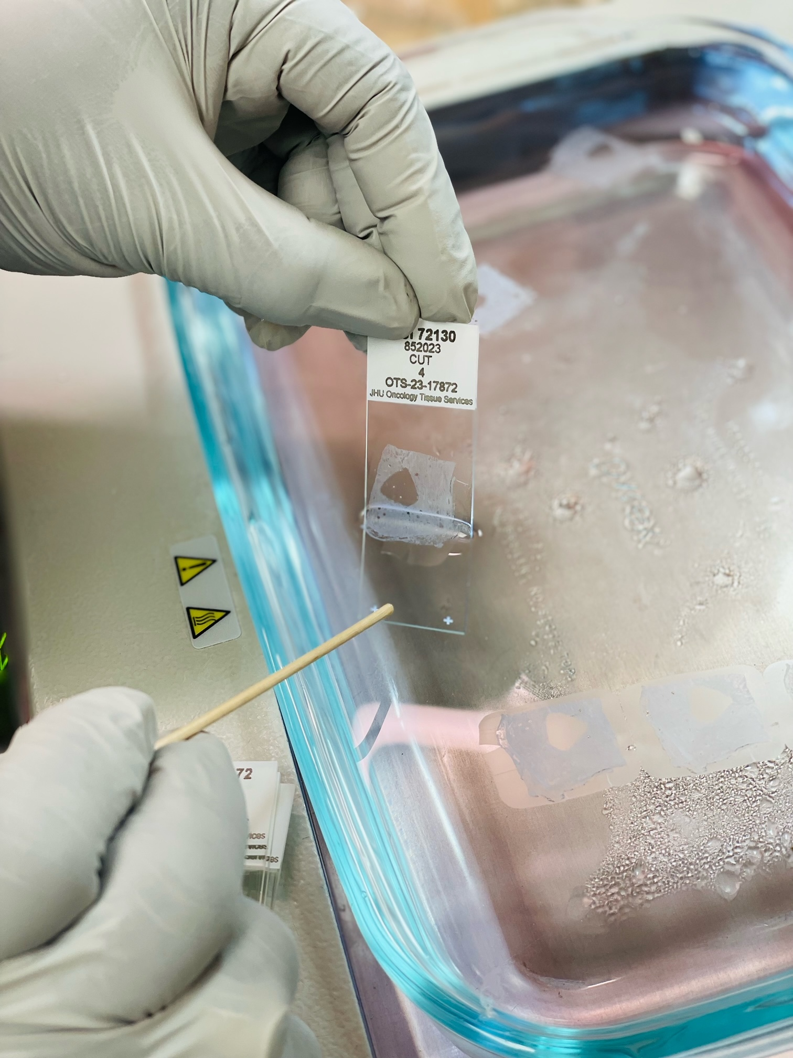
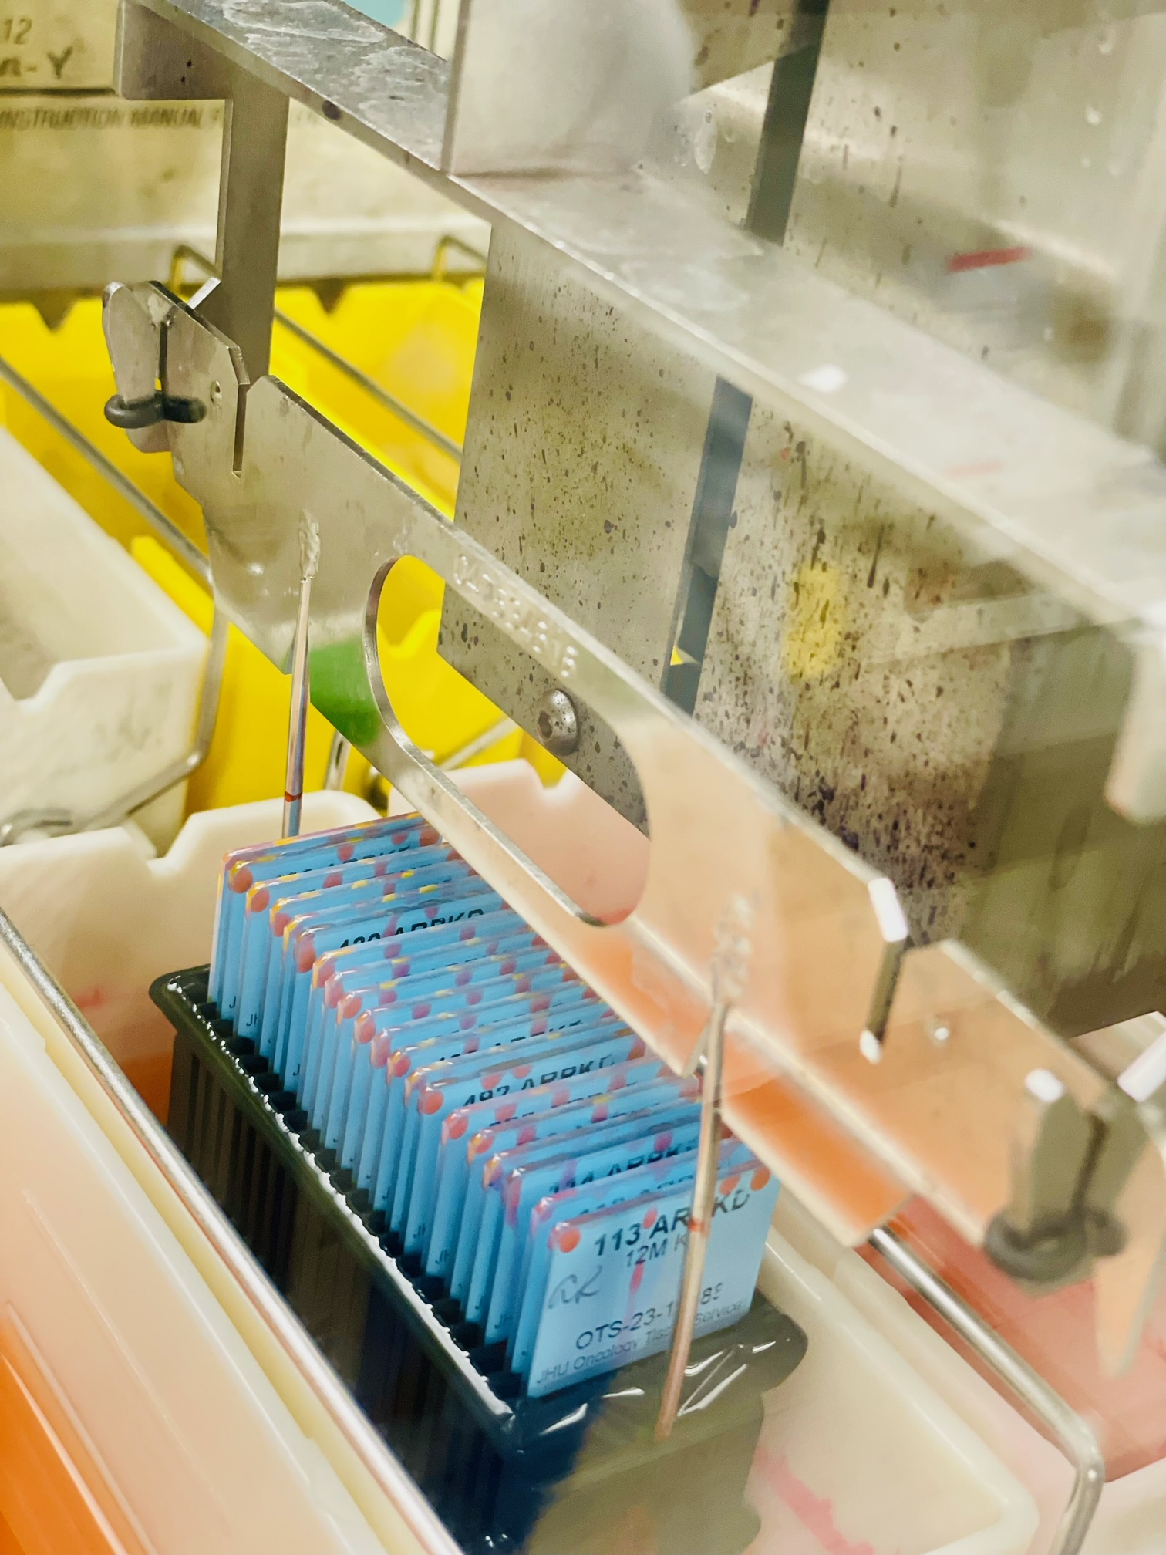
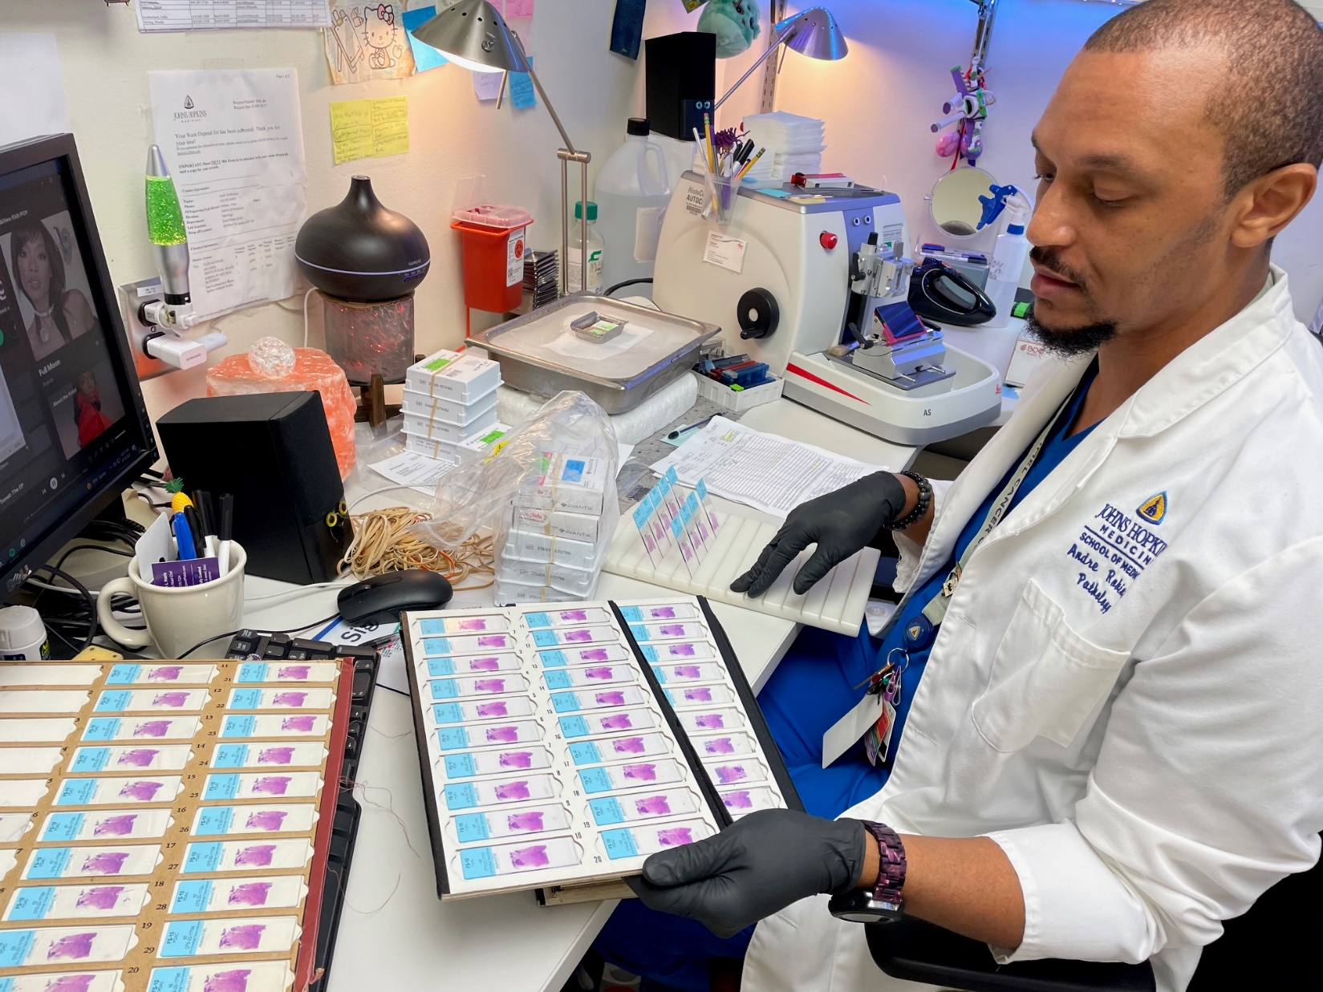
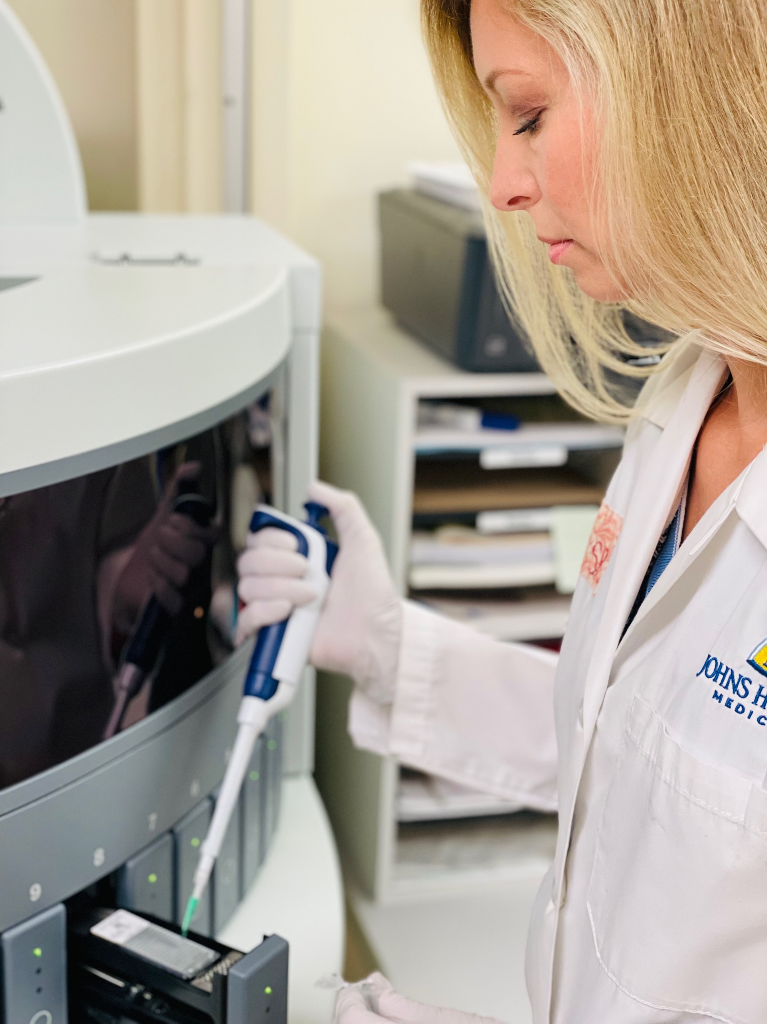
Services
Histology (grossing, fixation, processing, embedding, microtomy, cryosection, special stains: AFB (Acid-fast bacilli) & MAS (Masson trichrome))
Immunohistochemistry (IHC) – antibody testing, optimization & validations, and multiplexing
Brightfield and fluorescent slide scanning (1x3 scanning only) and 2x3 via Kristen (IF Specialist)
Immunofluorescent (IF) Scanning
Tissue Microarray (TMA)
*OTIS is solely a research lab, we do not process clinical tissue.

Slide 3
Partners
The Sidney Kimmel Comprehensive Cancer Center (Oncology Tissue and Imaging Services Shared Resources | Johns Hopkins Kimmel Cancer Center (hopkinsmedicine.org))
JHU Pathology Department
Pathology Laboratory Supervisor II (Katina Williams, kwilli34@jhmi.edu)
Clinical Laboratory Coordinator (Nora Viloria, nviloril@jhmi.edu)
Reference Laboratory Supervisor (Marquise Taylor, mblunt1@jhmi.edu)
For research related inquires, please direct email(s) to ResearchPathology@live.johnshopkins.edu
Central Processing Core (CPC)
Operations Director (Karie Brooks, kbenne11@jhmi.edu)
*Not a comprehensive list.

Slide 4
Registering/Accessing iLabs
OTIS requires all JHU affiliates and non-JHU affiliate users to have iLabs access.
To register for iLabs, please use the link provided: iLab Organizer (corefacilities.org). Click “Sign Up” and follow prompt.
*See to it each required field is appropriately filled out with the correct information (i.e., IO/budget # digits). Accounts registered incorrectly will not work.

Slide 5
iLabs Order Essentials
OTS number, Date, PI and Researcher’s full name, and one primary contact (email address)
IO / Budget Number / POTS # (please call to verify “pots”)
Tissue Type, Type of Fixative, and Fixative Date and Time
*RUSH samples (please select) Yes or No
Materials (i.e., type of slides, type of water)
Not applicable to “embed only” project
For cut tissue, “slide label rows” must be completed with 1-2 comparable block to slide IDs
Specimen Description (i.e., Rt upper lobe or RUL)
Specimen instructions/handling comments (i.e., special requests/ grossing/orientation specifics, etc.)
*OTIS is not currently doing RUSHES until further notice.

Slide 6
Specimen Handling
Samples brought to OTIS must be properly labeled (no patient information) with 1-2 “sample identifiers” (i.e., BCR or BCR-1.5t) and in fixative (size appropriate close container*).
Recommend, 10% Neutral Buffer Formalin (NBF or formalin for short) or a Formalin derivative (4% Paraformaldehyde (PFA)).
Optimal fixation time, 48hrs (highly recommend). Minimum: 24hrs.
To prevent over-fixation, we recommend samples already fixed for 48hrs be transferred and presented to OTIS in 70% Ethanol (except for brain tissue (ETOH cause vacuolization (holes)) in brain tissue when placed in 70%) or Phosphate-Buffered Saline (PBS). Use PBS for brain!
All solutions can be stored and transported at room temperature.
Sample “Drop OFF” time is Mon.—Fri. from 10AM-1PM (not including federal or JHU confirmed holidays), so samples delivered after 1PM or on holidays* will not be accepted.
*Sample containers are available on site if needed.
*Holiday restrictions will be posted as needed.

Slide 7
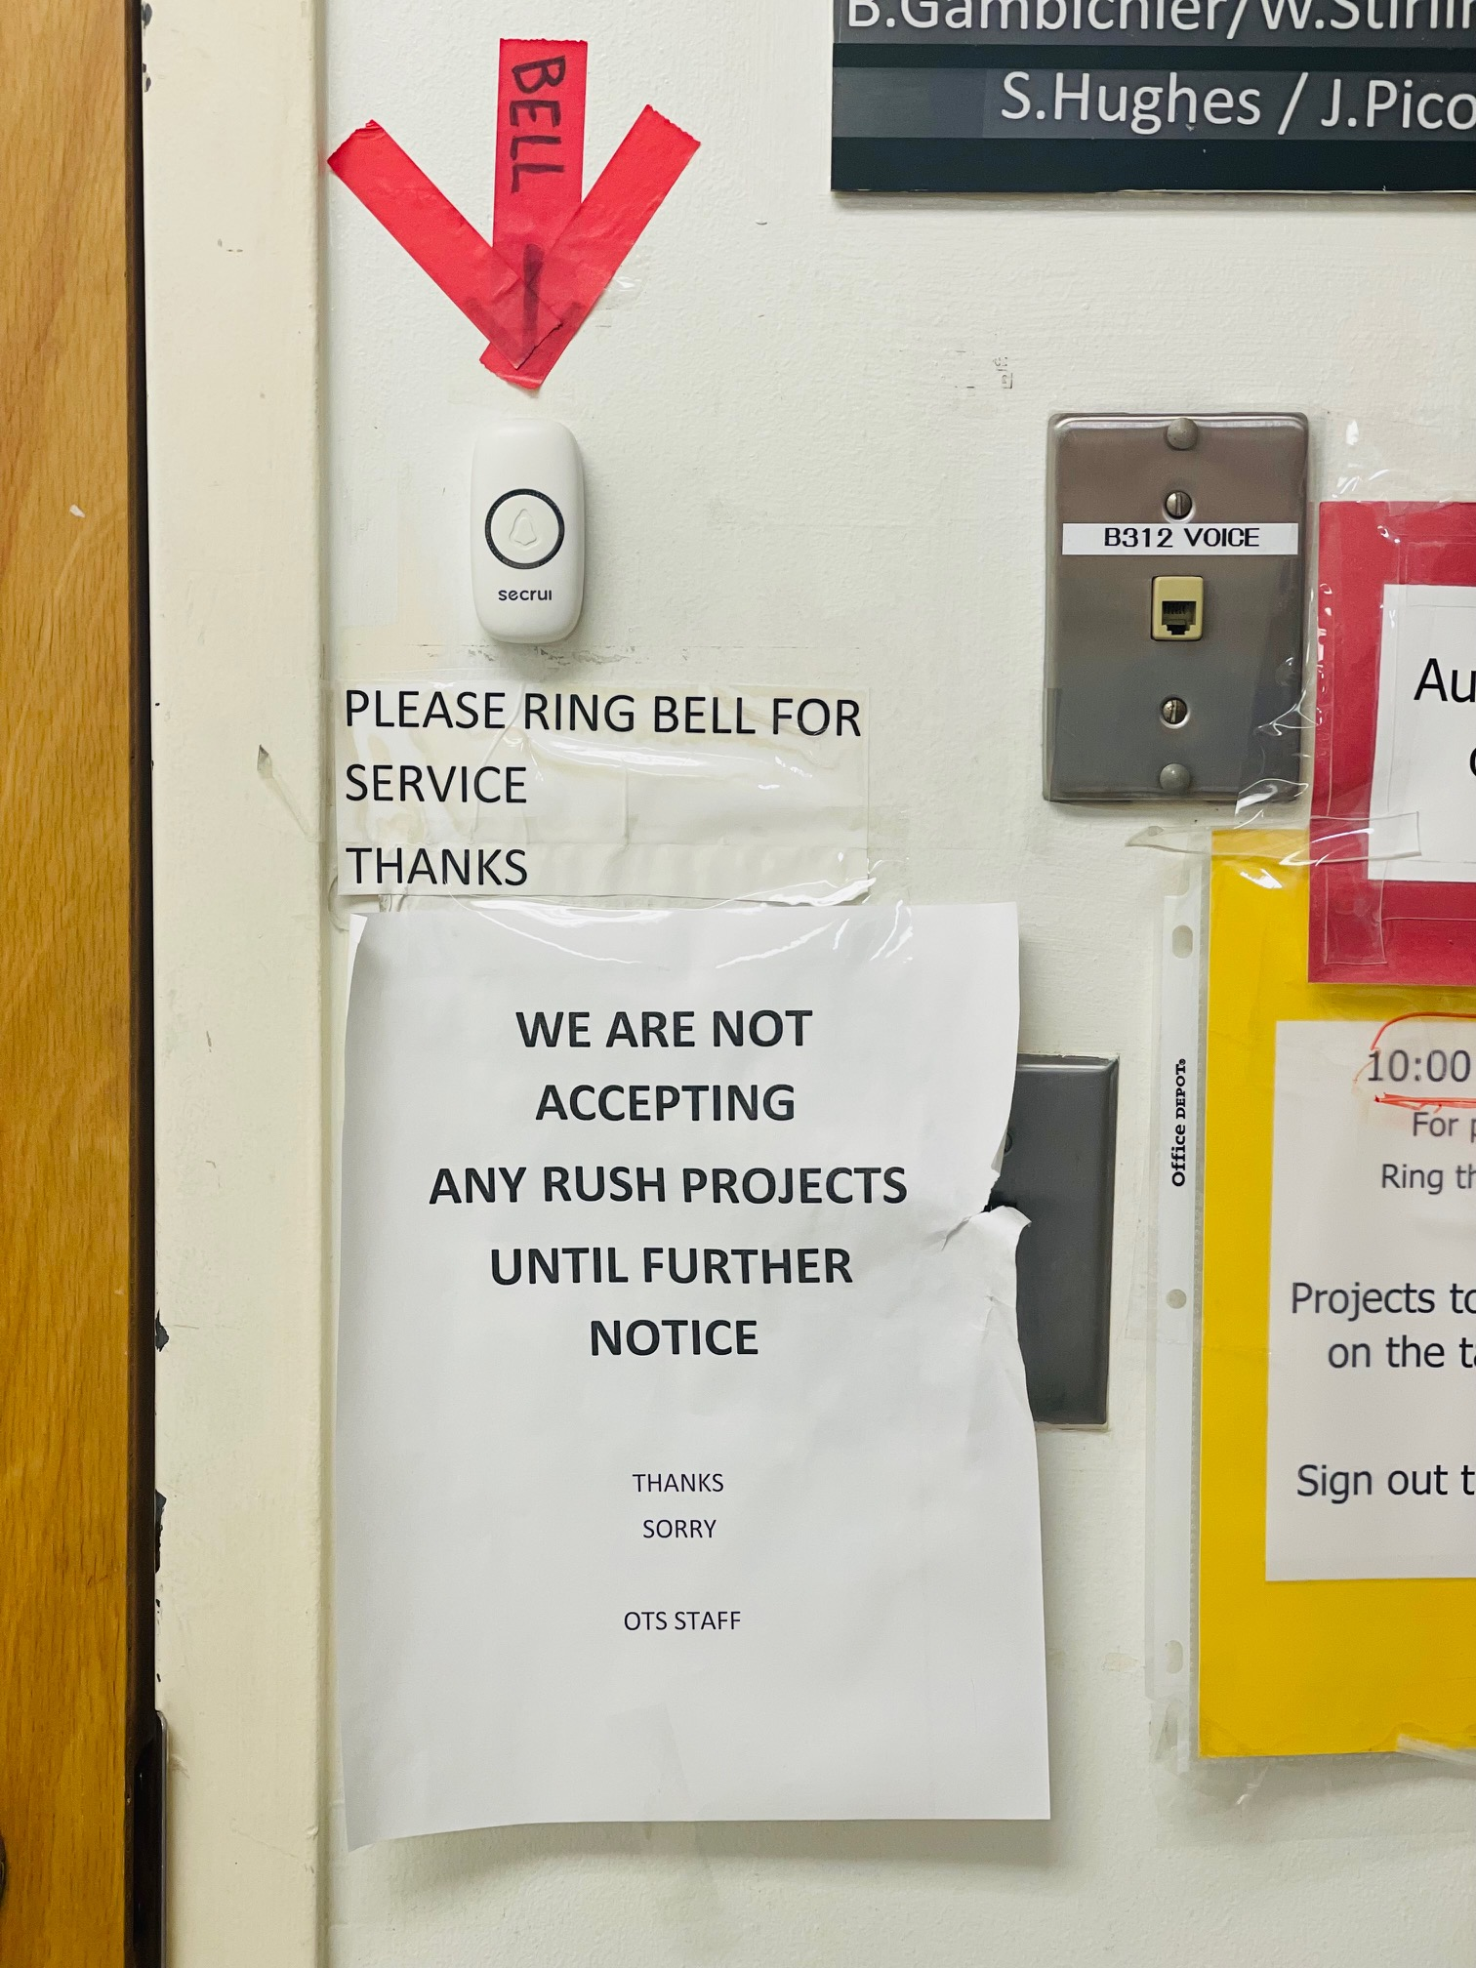
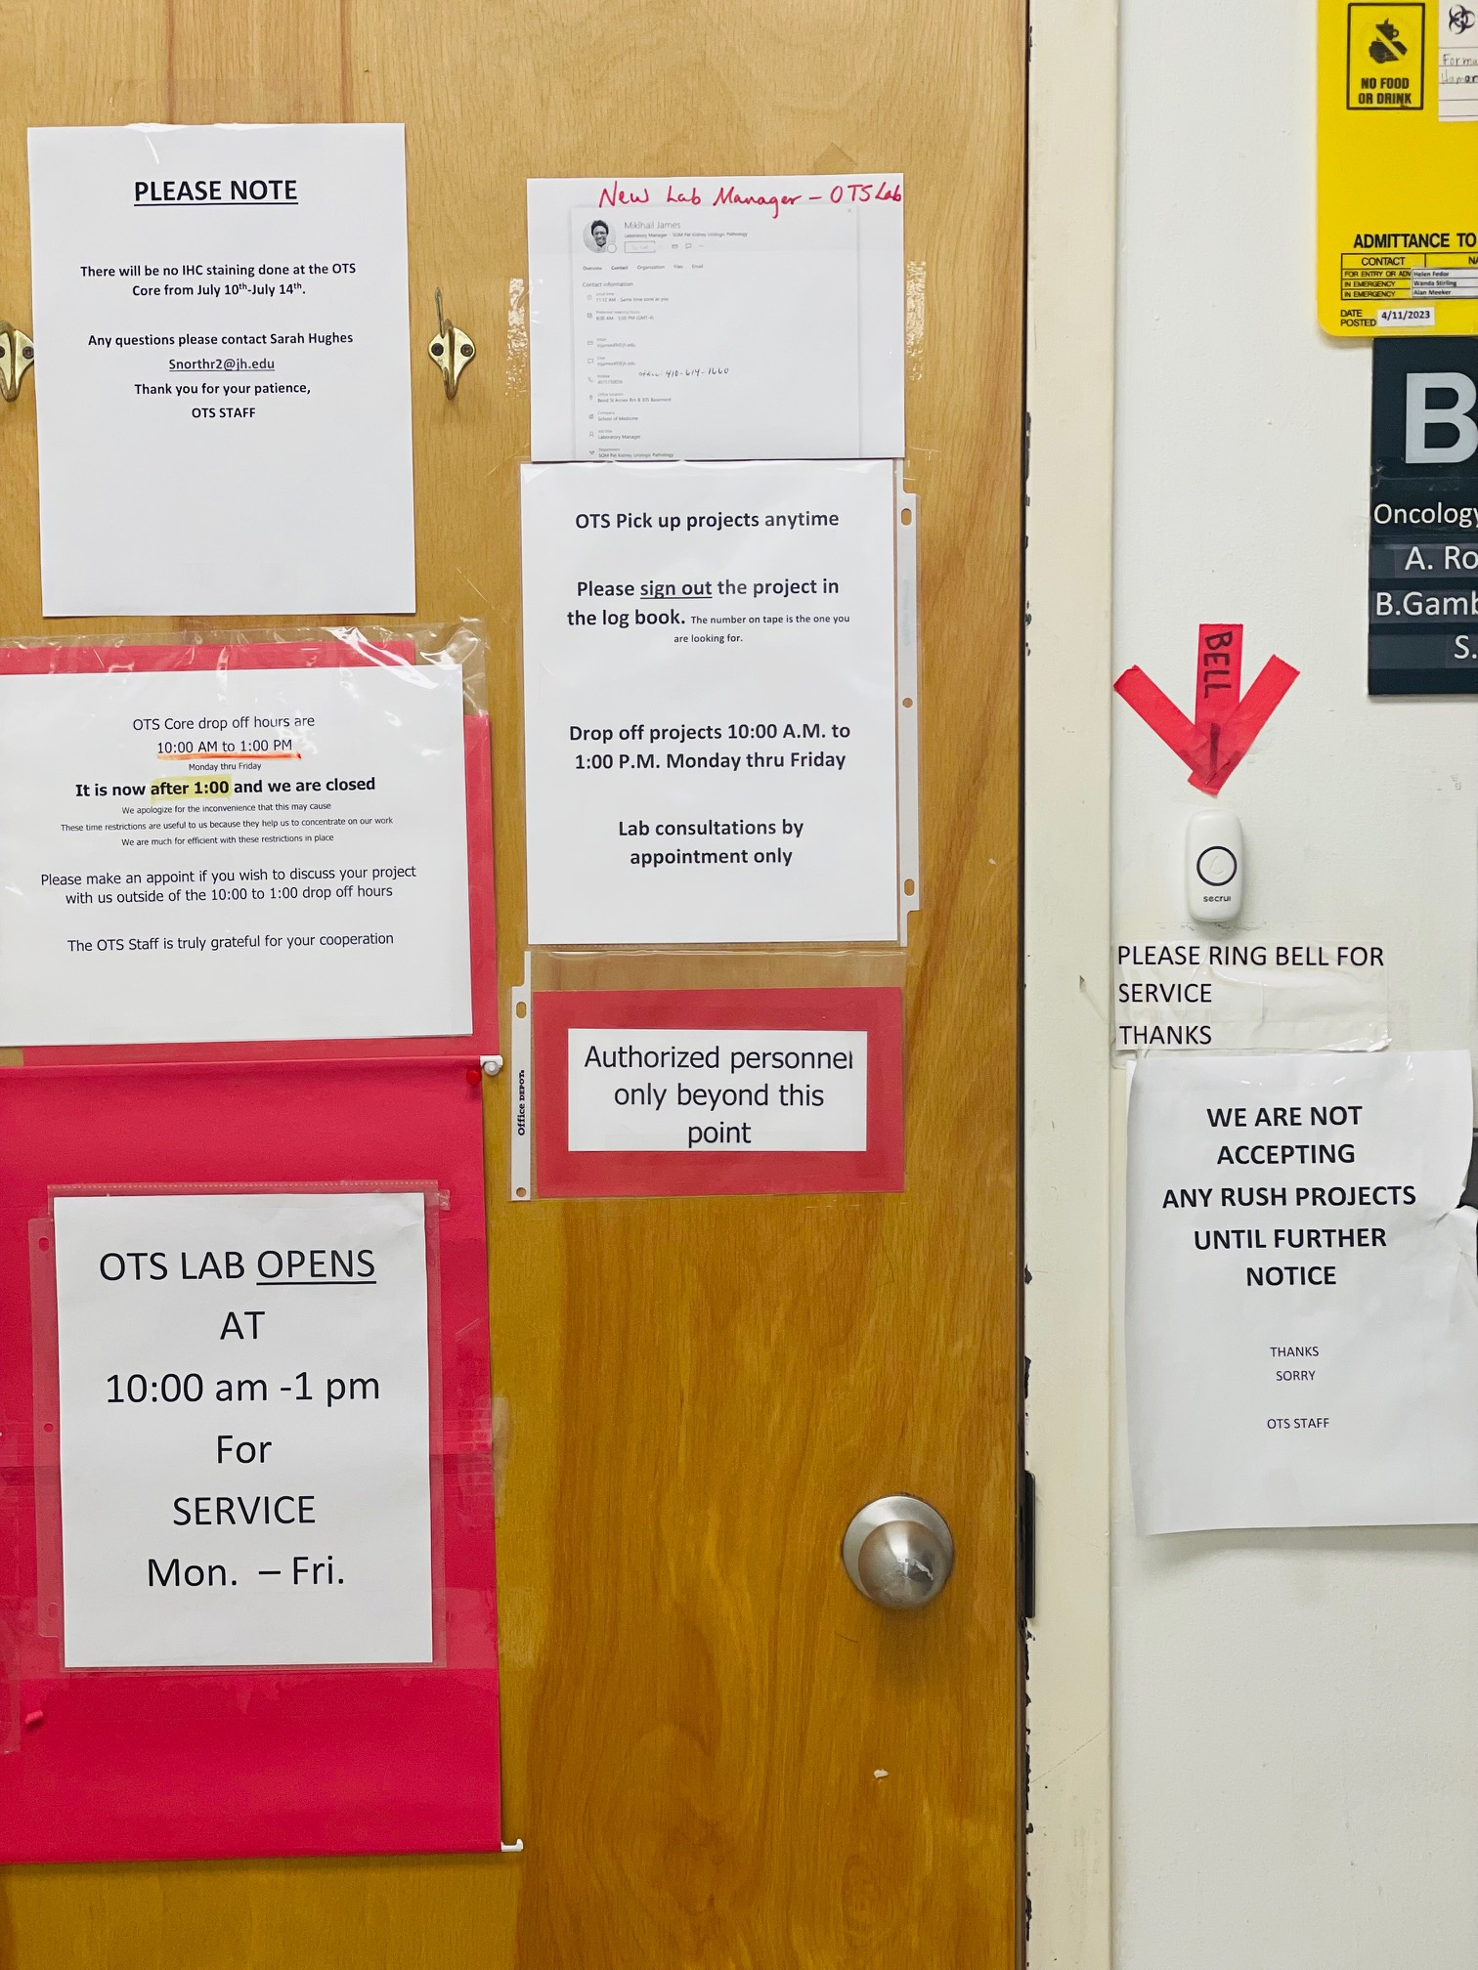
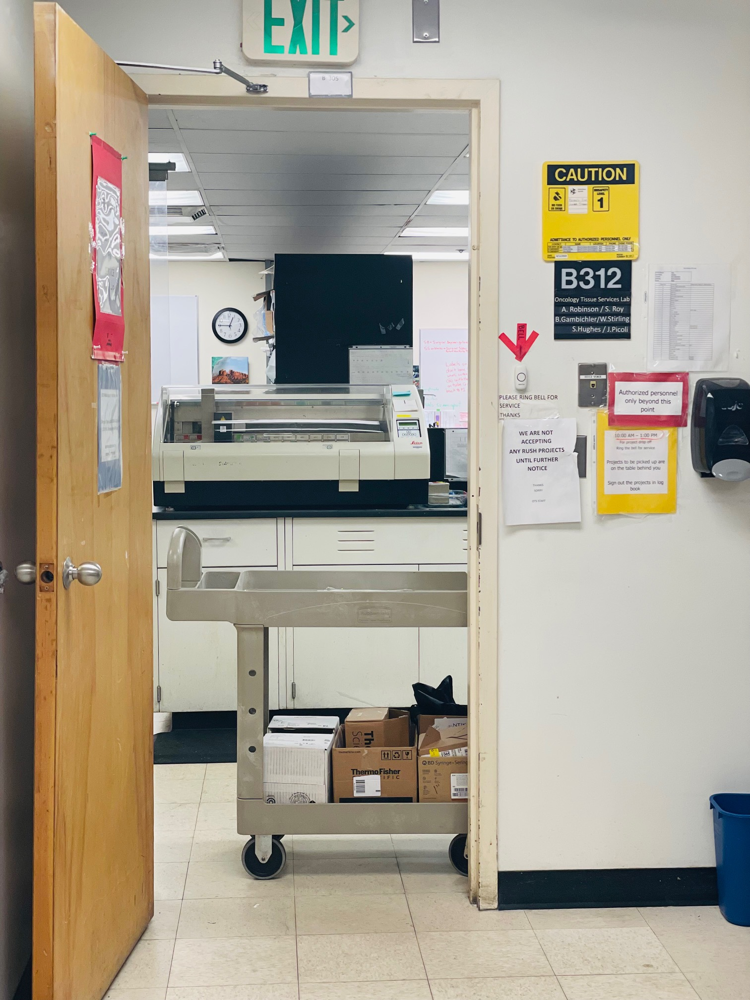
The MUST for Drop OFF
Sample(s) must be entered into iLabs prior to drop off.
Sample(s) containers must be closed and labeled, and the order sheets must be filled out correctly (please include any (i.e., grossing, embedding) instructions/comments in the comment box). If there are no relevant instructions or comments, please specify that as well.
Researchers must have “two” copies of the order sheet present at drop off.

Slide 8
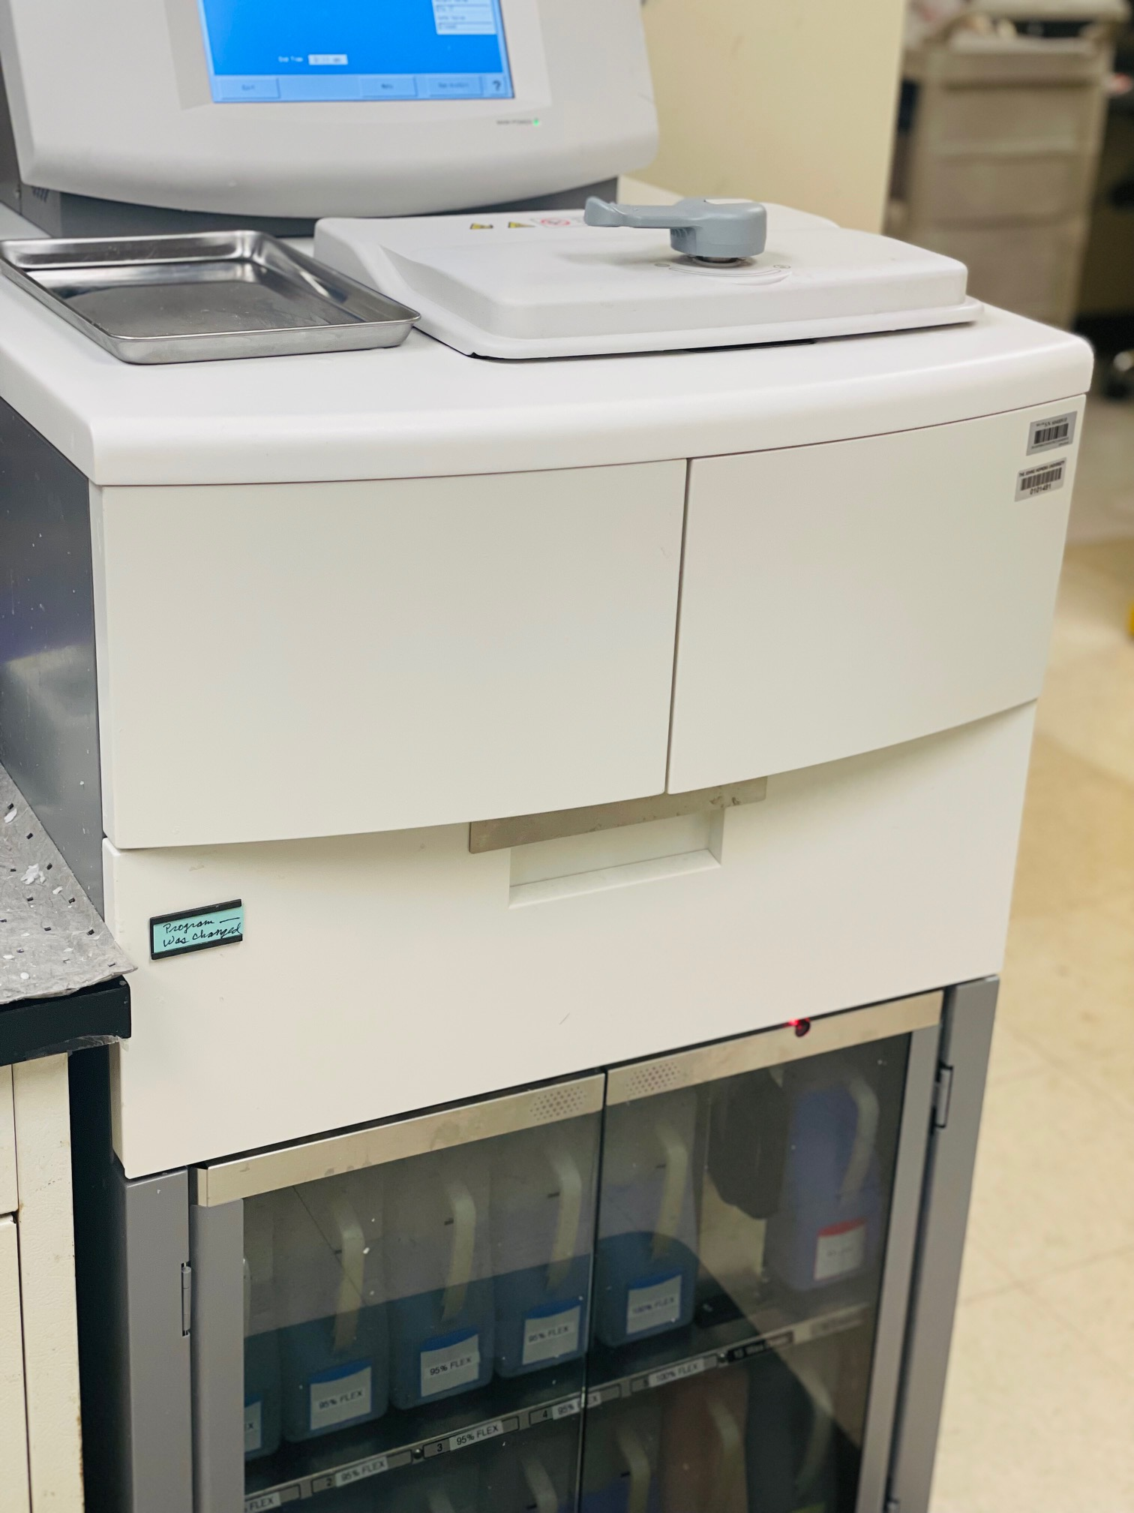
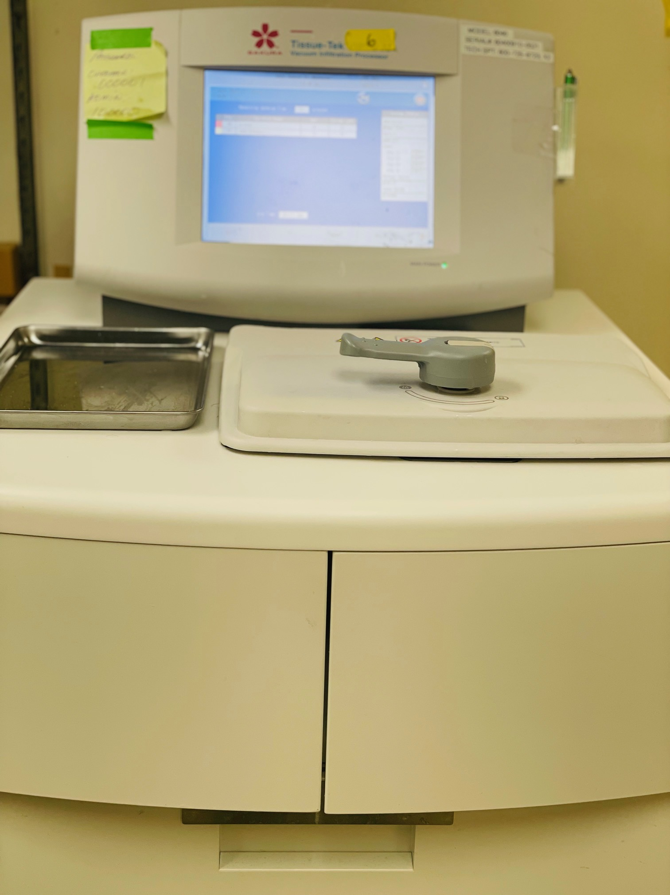
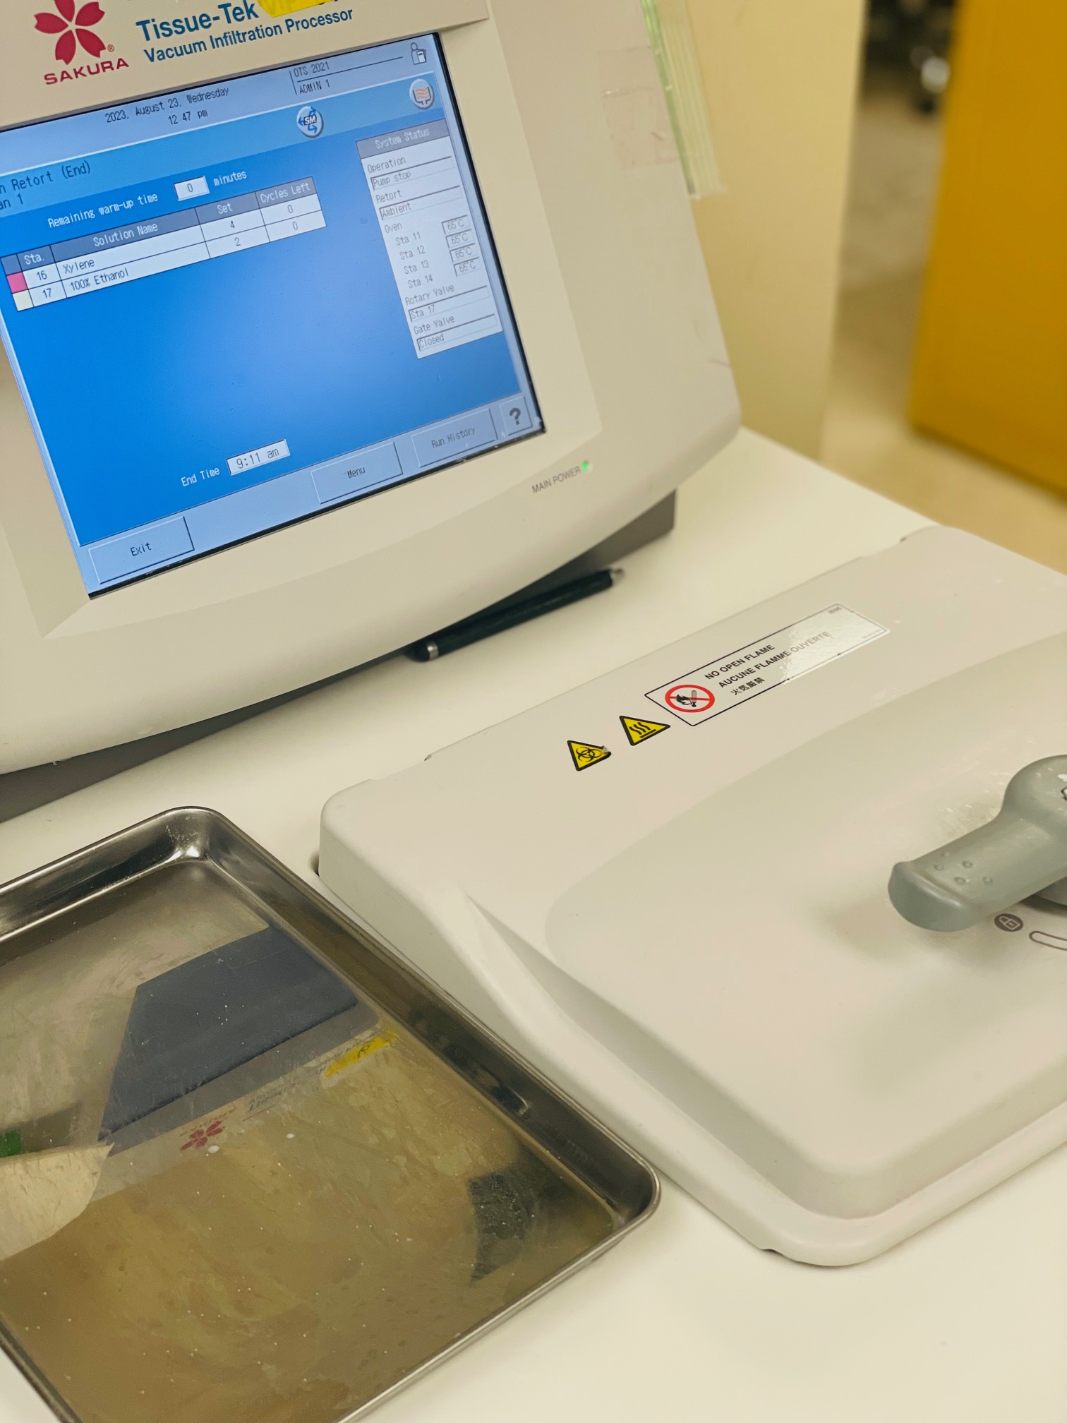
Processing Tissue and Times
Before processing begins, each sample is triaged (i.e., grossed) to view the integrity of the tissue and define the next course of action.
Processing time is determined predominately by tissue type: cells, skin, fatty, bone, brain, etc. and by quantity (amount of samples prepared).
Processing times are categorized into “programs”: 1, 2, 3,… etc., up to 8.
Processing time can range from 2.5hrs to 40hrs. Average 2.5 – 8hrs.
After each run (use), the machine must be cleaned. Cleaning time: 1.5hrs
Processors only run “two” times a day; 11AM and 4PM
OTIS has 3 machines, each hold 100 blocks per run. Theoretically, at max capacity: 300 blocks total per run; 600 blocks per day.*
*Have the potential to run 600 blocks, but we average 200-400 blocks per day.

Slide 9
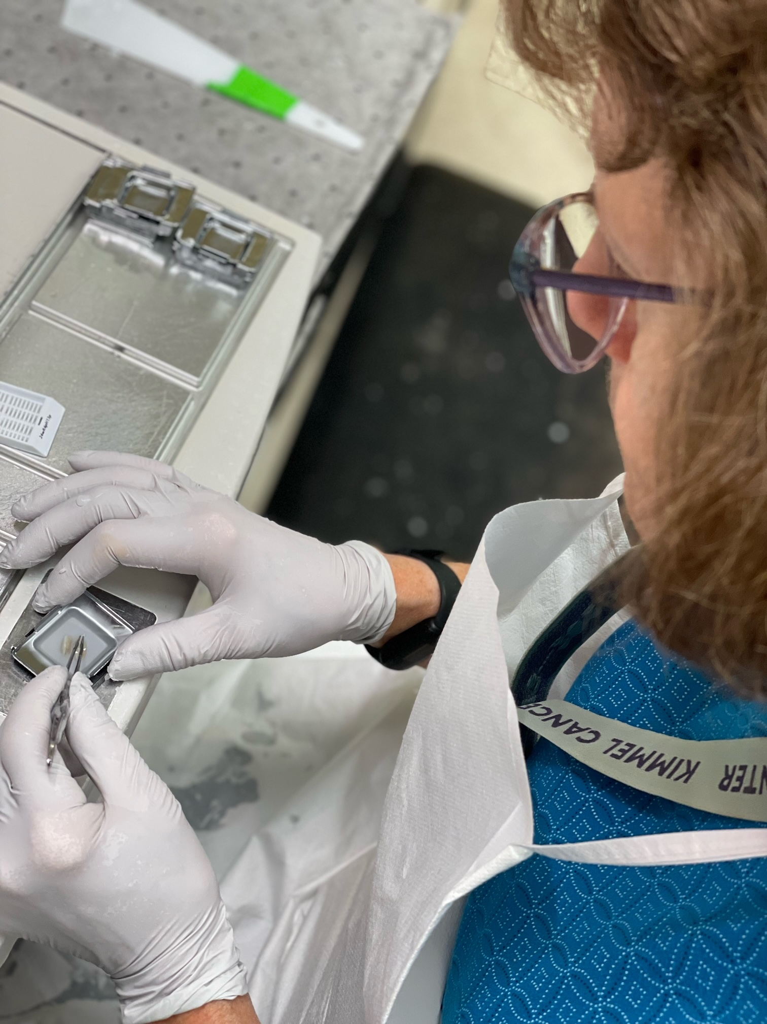
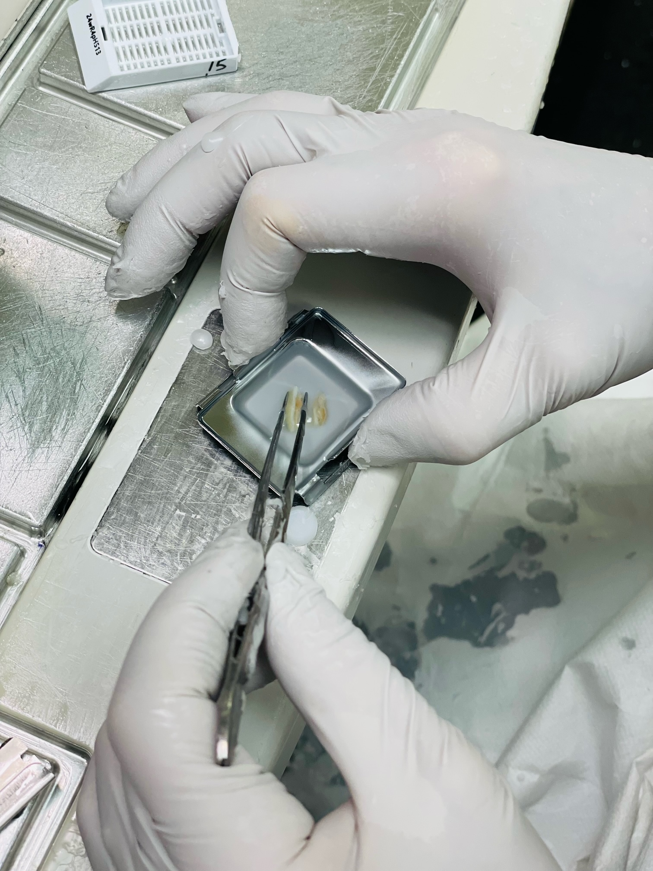
Embedding
The purpose of processing is to further stabilize the tissue for embedding.
During processing the tissue was carefully dehydrated and then “rehydrated”—infiltrate with paraffin wax.
The same paraffin wax is used to house the tissue sample in cassette molds (once it solidifies) in preparation for microtomy.
Tissue blocks are cut (sectioned) at various thickness (microns). Routine section: 4um. 4 micron = 0.004 mm thick (better perspective 100 um = 0.1 mm)

Slide 10
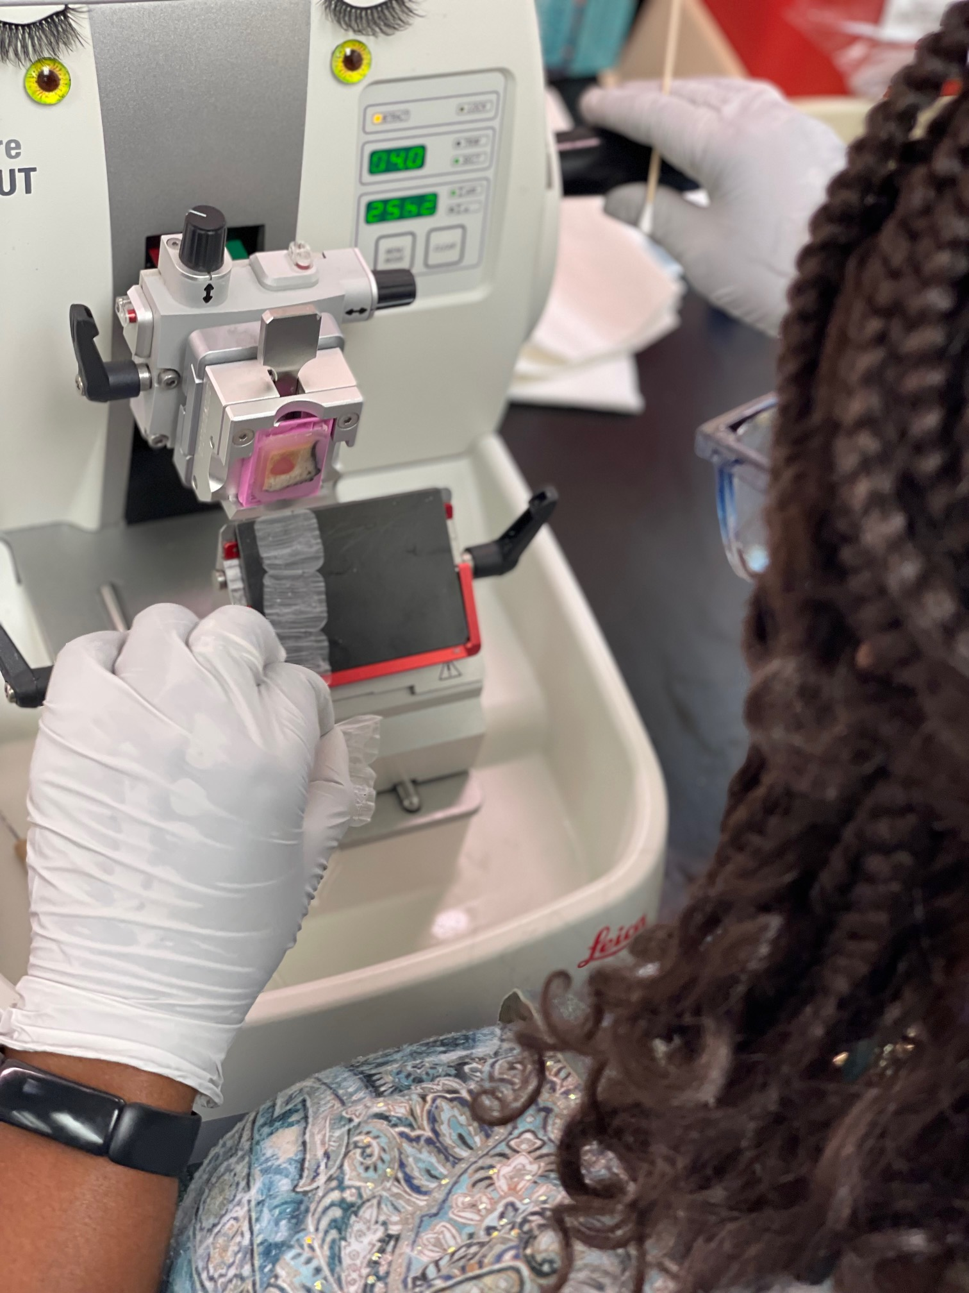
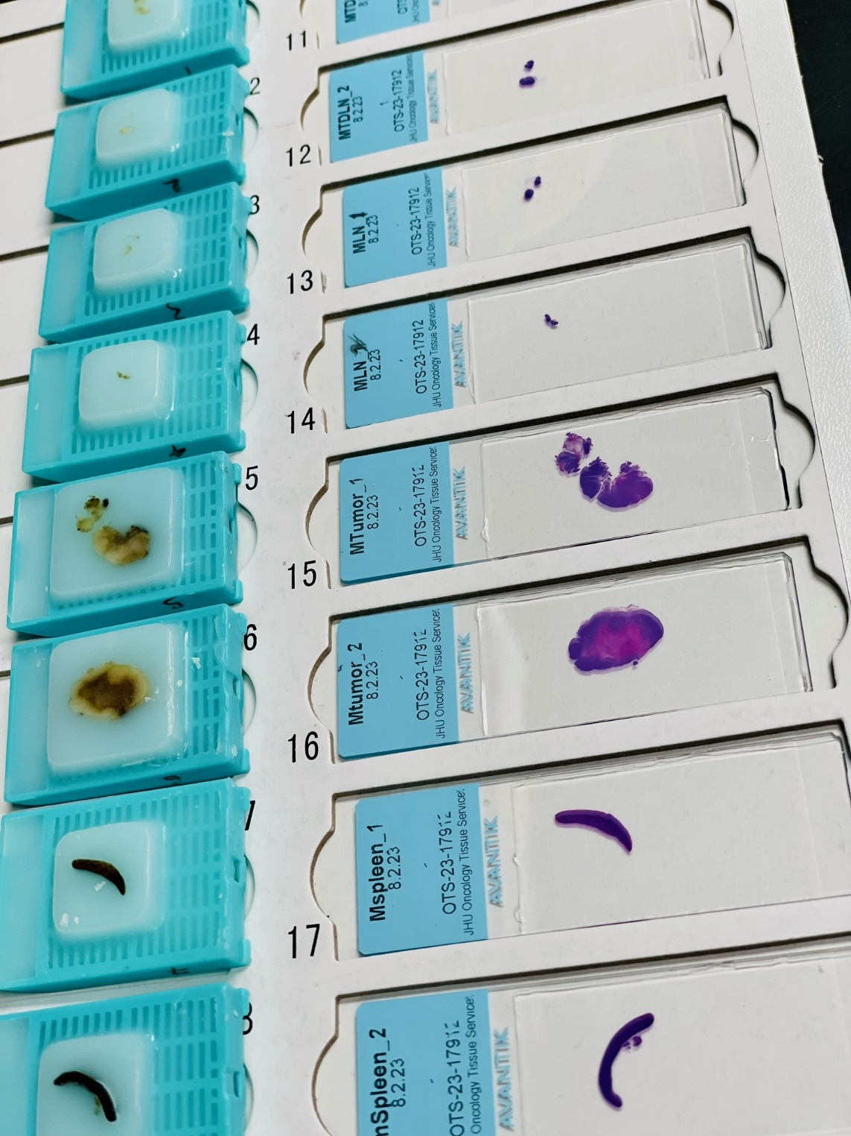
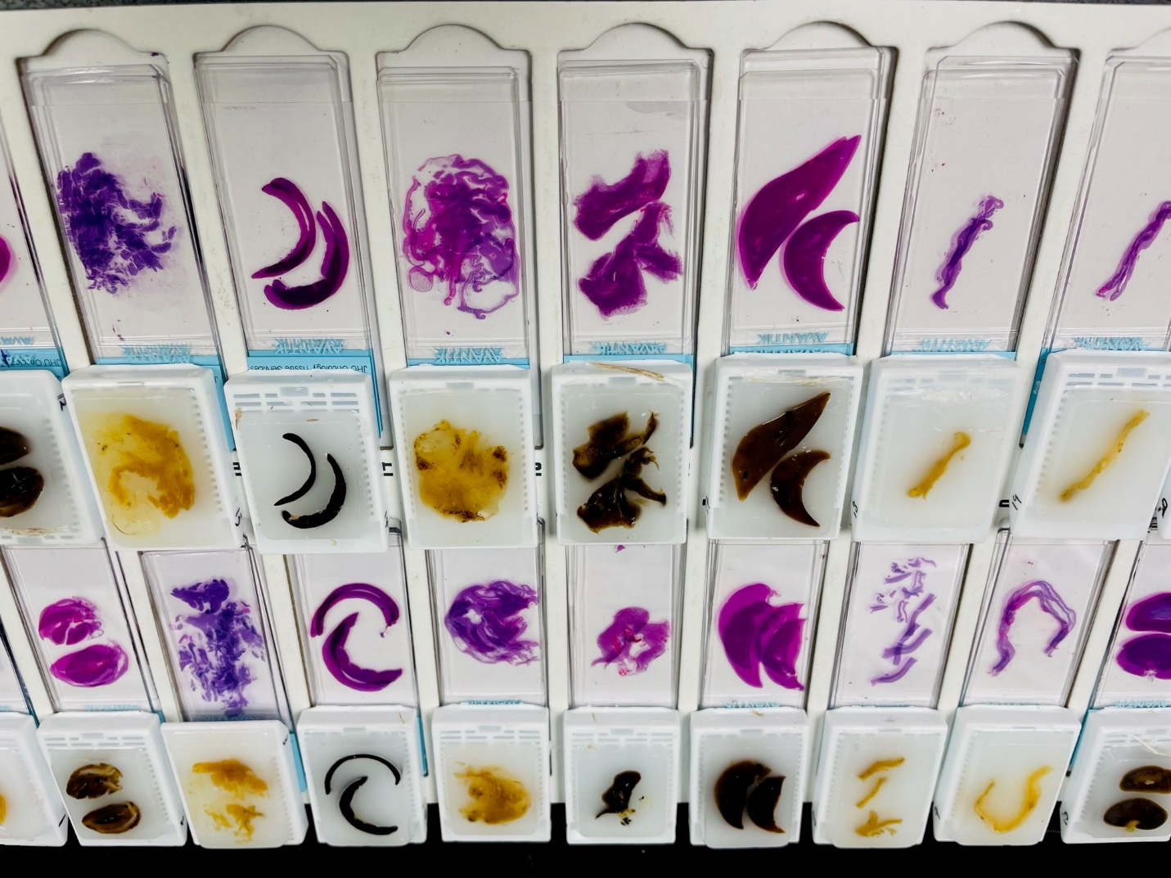
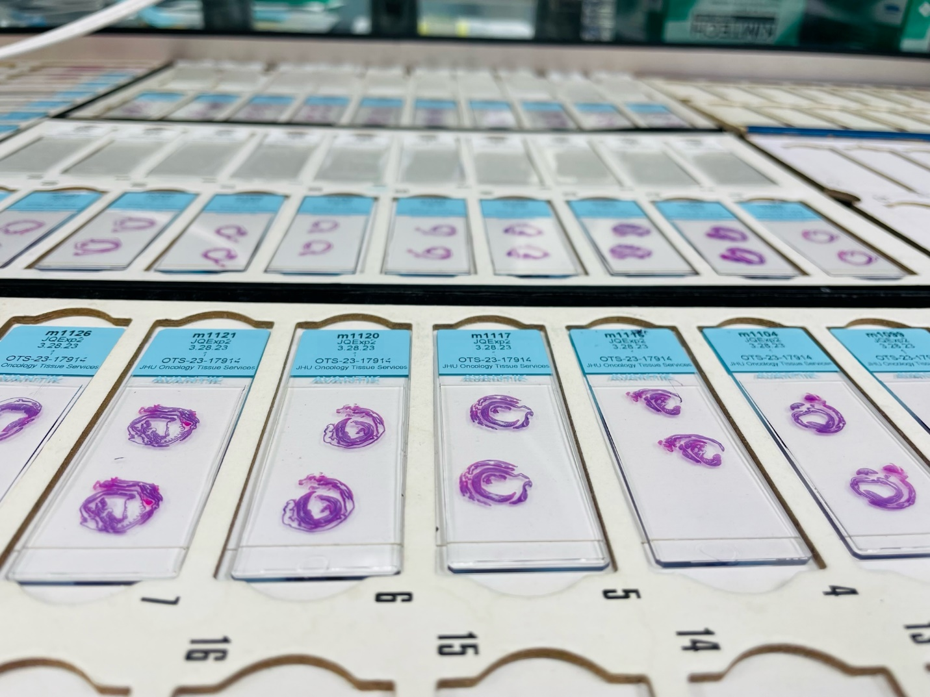
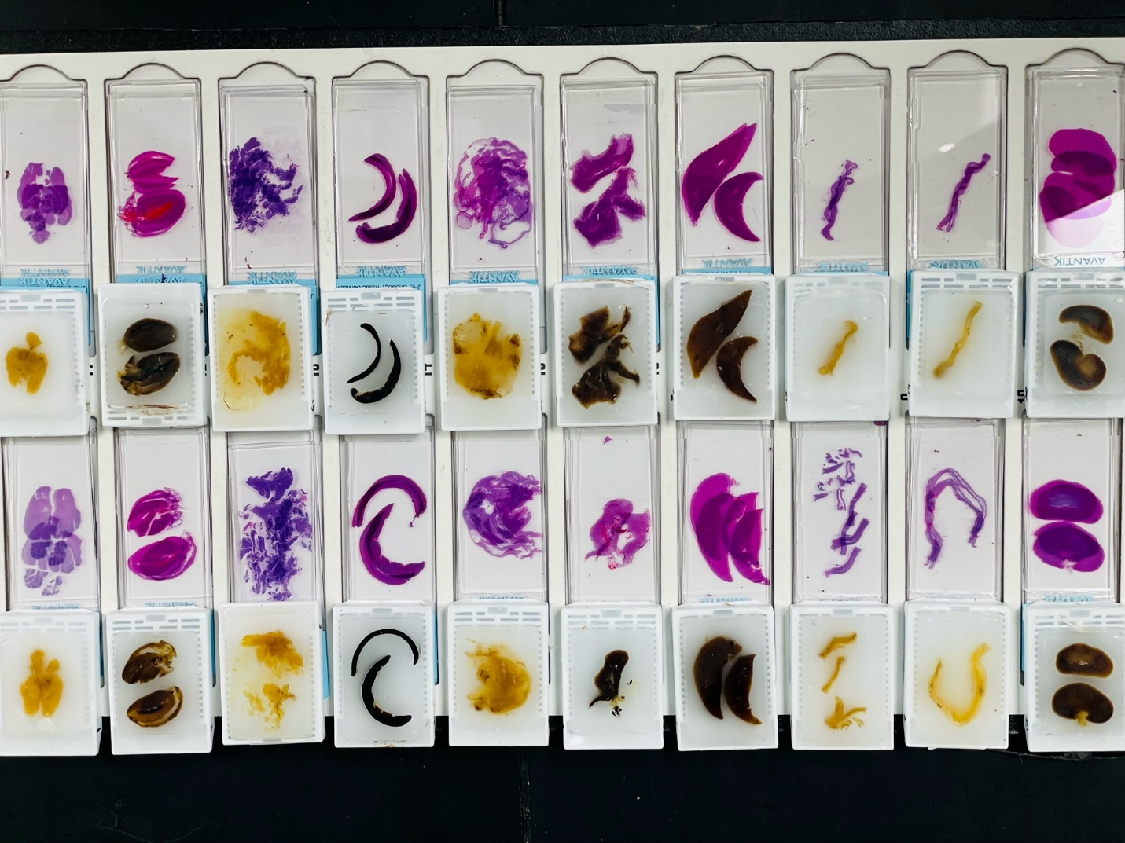
Microtomy
The mechanics of sectioning tissue blocks.
Common practices: H&E, serial sections, levels, unstained, exhaust block.
With microtomy, terminology is very important.
How samples are cut can validate results or render results inconclusive. Common causes:
Thickness of the tissue… depth or amount of tissue available for sectioning
Where in the tissue is the site of interest… surface, middle, back (end)
Site of interest is in correlation to what… skin, organ, membrane (margins)

Slide 11
General Terms and Phrases for Microtomy
Face Up/Full Face – cutting technique used to resurface the embedded tissue within the block towards/onto a singular plane
Trim/Cut – method used to remove tissue sections from off the block for microscope slide(s)
Section – single representation of the sample tissue from off the block
Ribbon – 4-8 serial sections joined together (can be more) of sampled tissue
Serial sections – sections retrieved in sequential order
Levels – single sections retrieved at various depths within the tissue (50um intervals, minimum)
Cut-through – serial sections of the entire tissue sample within block (depending on tissue size, can be ≤1,000 slides per block)

Slide 12
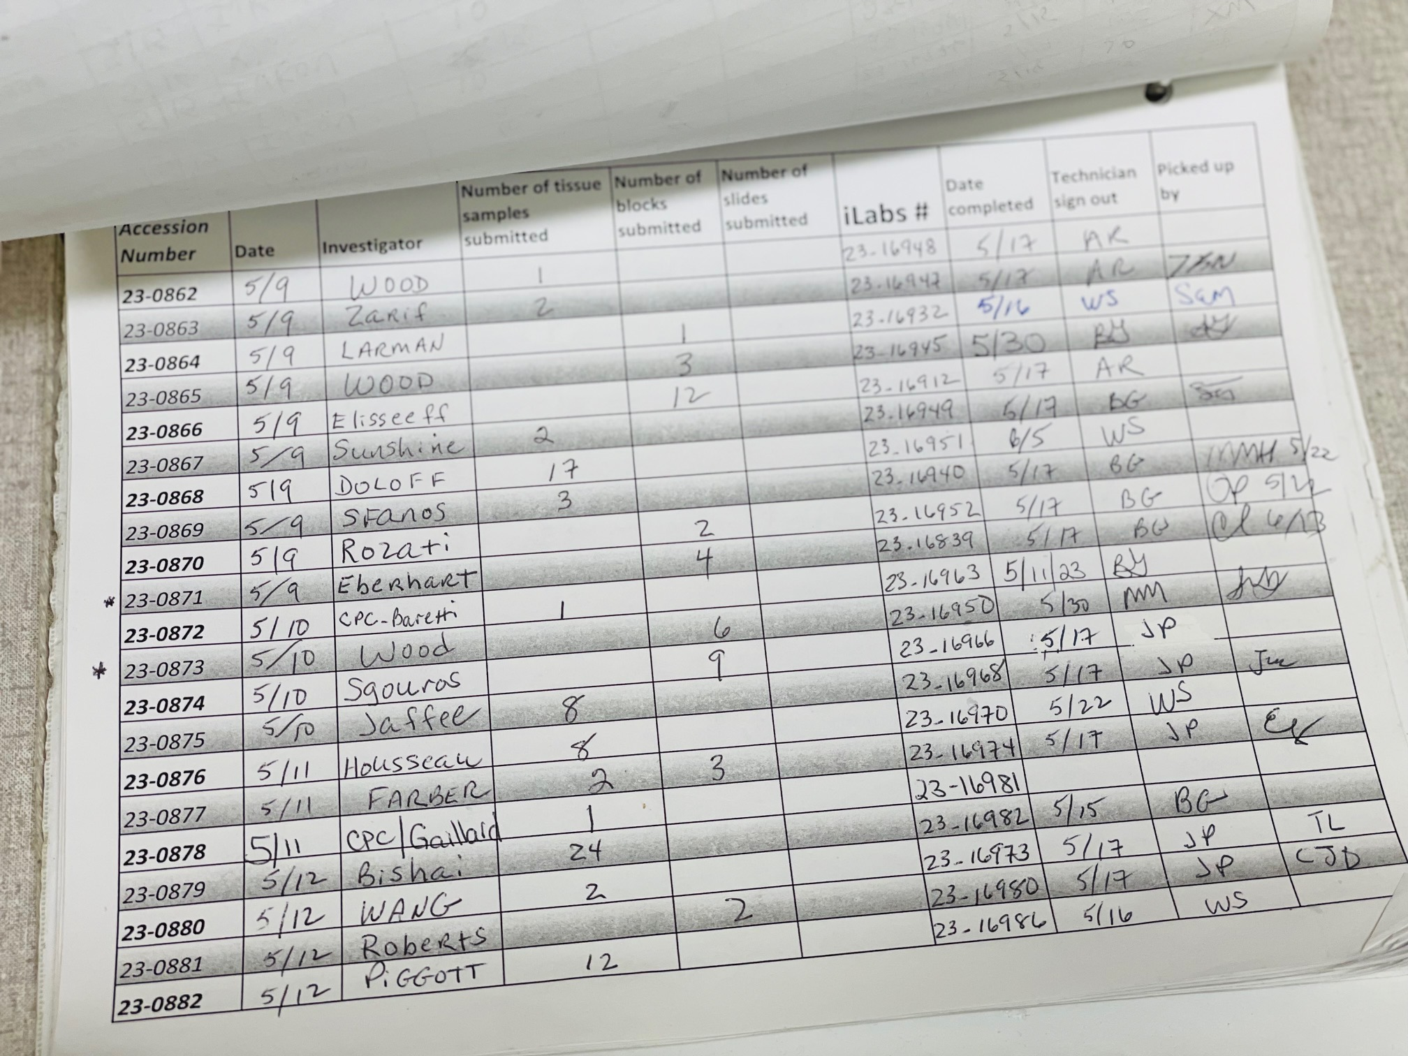
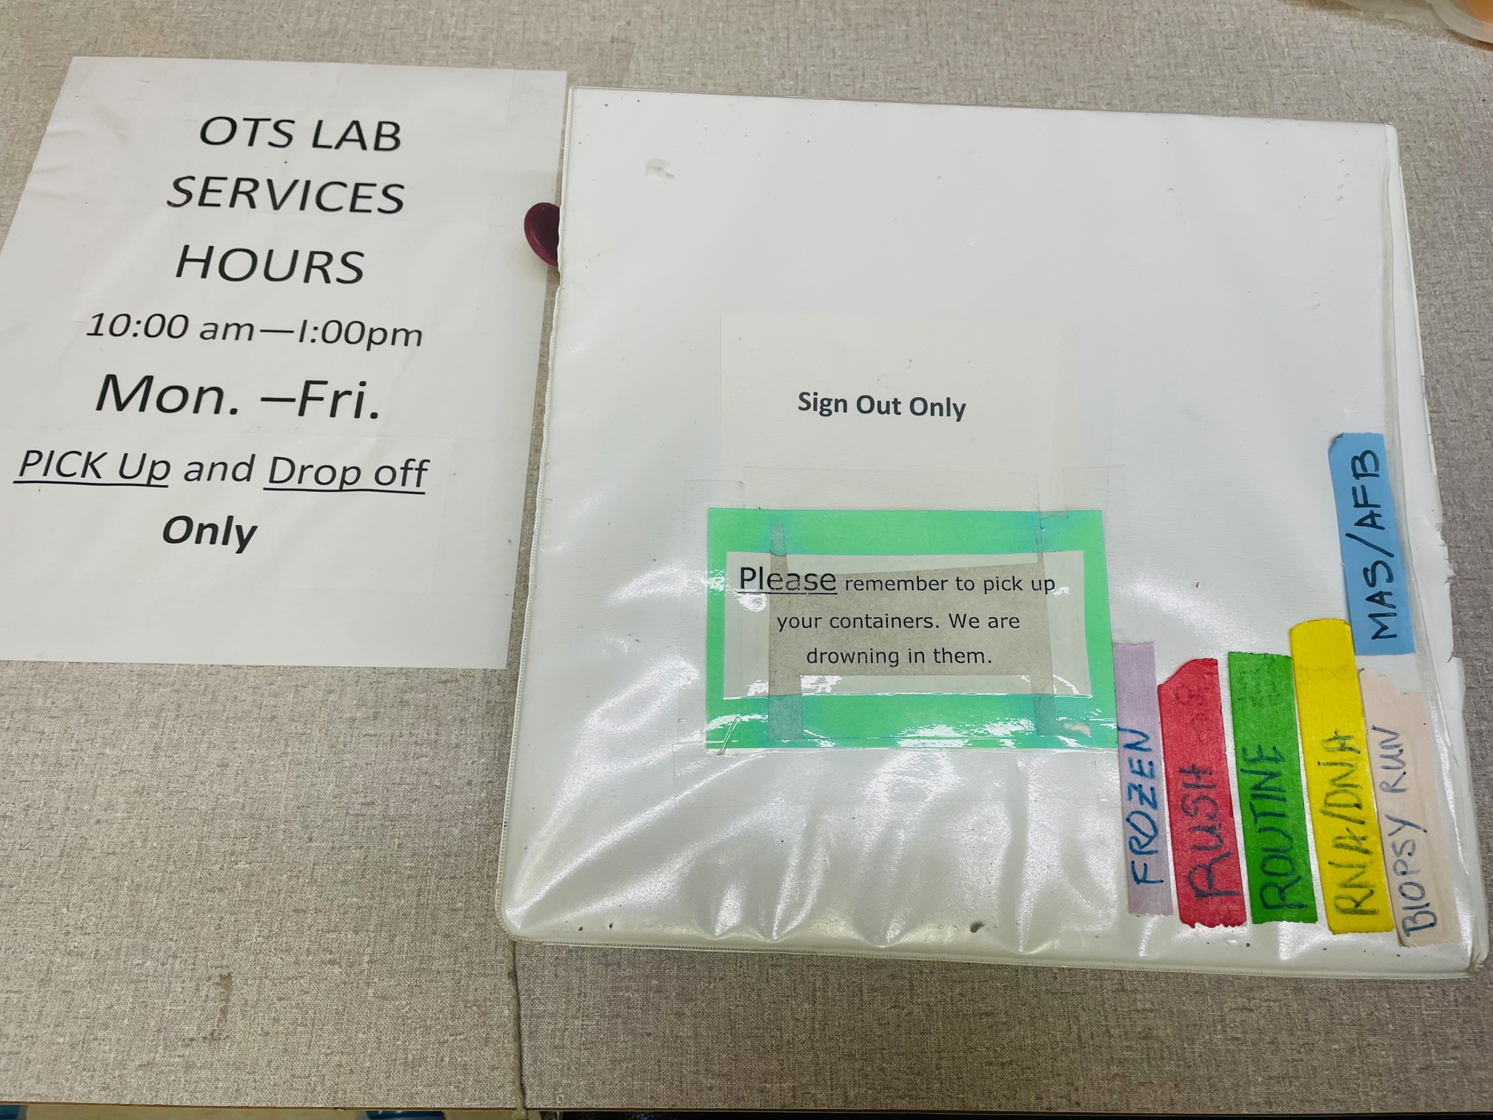
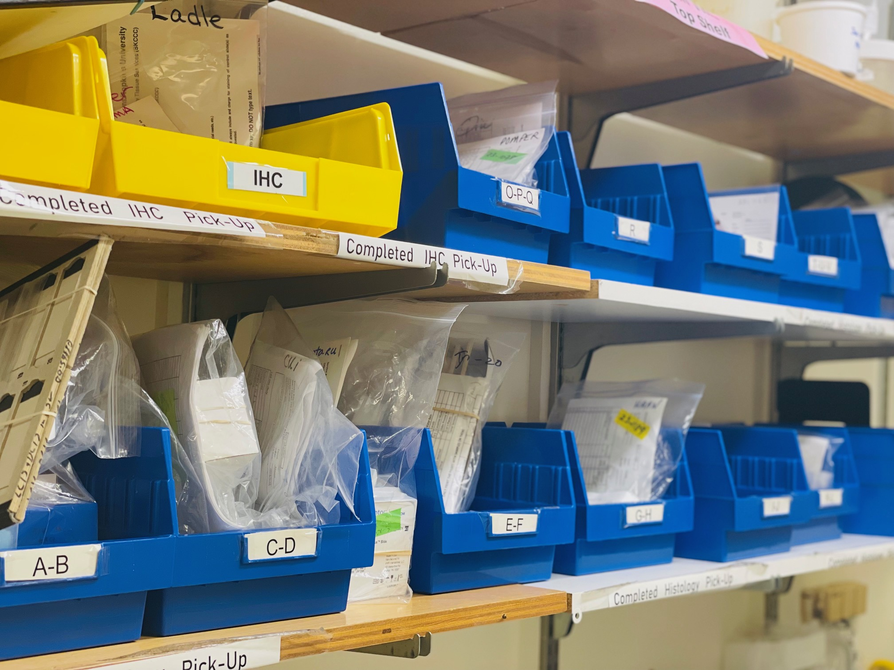
Completed
As samples are being processed, researchers will be notified via email when/if changes occur.
When samples are completed, researcher will also be alerted via email.
Samples are place at the “drop off” site (back hallway door of lab) in blue bins (alphabetized).
Samples are organized an distributed by principal investigator’s (PI) last name.
User must date and initial occurrence of pick up.

